Slide 1
Automated Healthcare System during Catastrophe

Slide 2
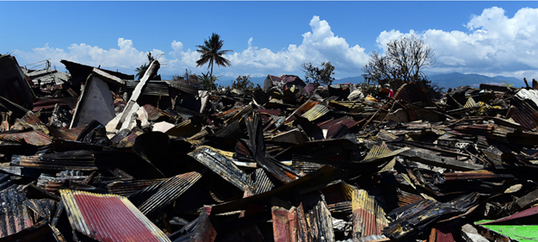
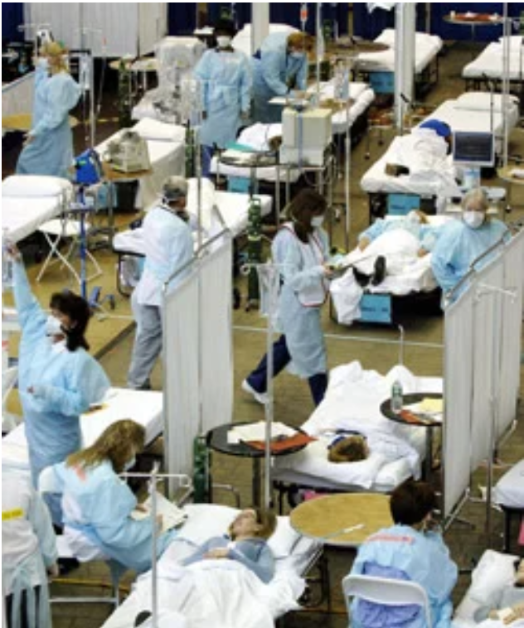
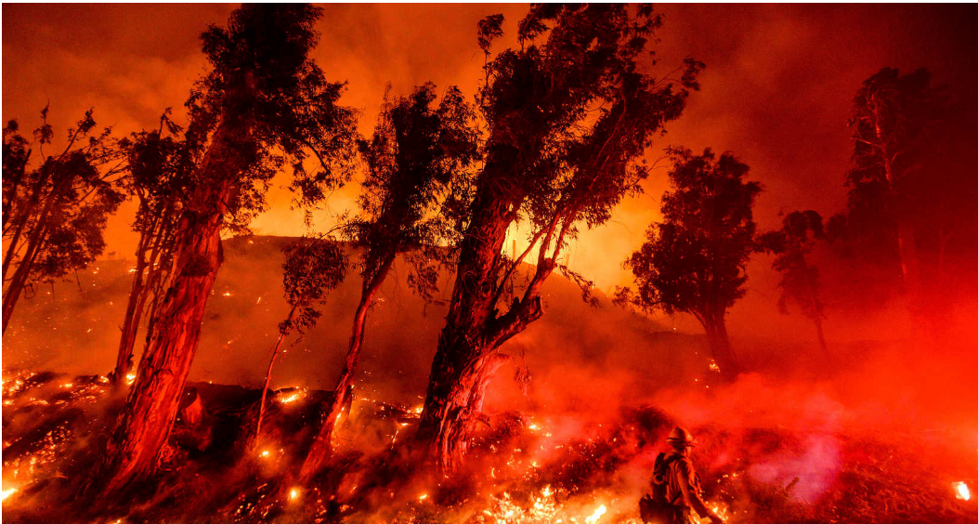
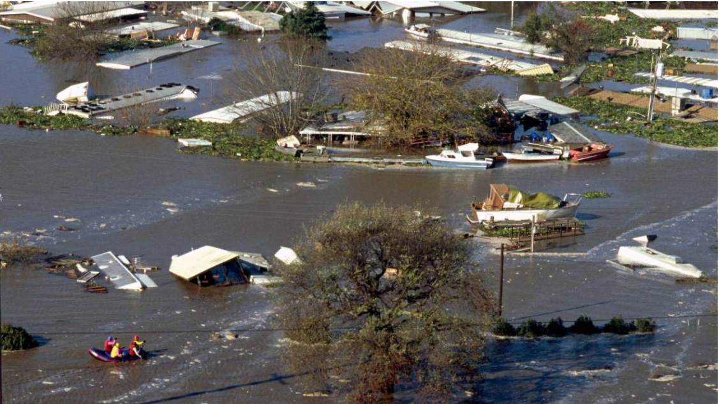
Motivation
Disaster recovery
Require health care organization
Hospital during disaster

Slide 3
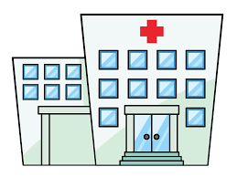
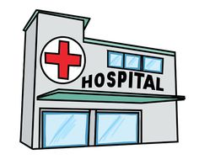



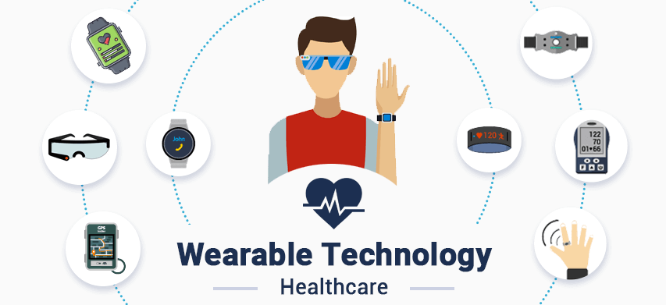
Share data
Front-line check-in (fingerprint identification)
Fingerprint scanner station
Handheld fingerprint scanner
Advantages
Eliminate the need of card
The faster check-in process
Can identify unconscious patients
Access by fingerprint
identification during riot
Utilize global data bases
(shared treatment history among hospital)
Automated Health System
Blood pressure
Heart rate
Temperature
Prioritize patience based on injury
Wearable device that can collect initial health information of patients.
Decrease workload of medical staff during rush hours.

Slide 4
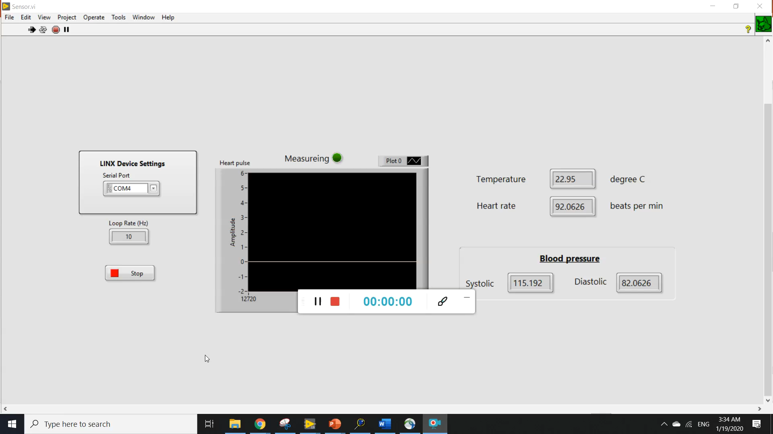

Slide 5
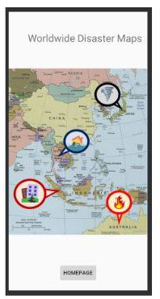
We also create channel to
- clarify the need for relieving victims
- external people can find the way to support.
Worldwide disaster
Update the situation
News
Article
Ex Scientific knowledge about the root of the disaster
Can satisfy the needs of victims
Provide information for
people who want to help
External people can find the way to support

Slide 6
Reference
https://www.cooking-hacks.com/documentation/tutorials/ehealth-biometric-sensor-platform-arduino-raspberry-pi-medical
http://wiki.seeedstudio.com/Grove-Temperature_Sensor_V1.2/
https://learn.sparkfun.com/tutorials/fingerprint-scanner-gt-521fxx-hookup-guide/all
https://learn.adafruit.com/ir-breakbeam-sensors/arduino
https://news.un.org/en/story/2018/10/1022722
https://www.voanews.com/usa/firefighters-gain-wildfire-southern-california-farm-country
https://www.kqed.org/science/1915937/california-cities-will-flood-so-why-arent-we-ready
https://stackoverflow.com/questions/48745019/alexa-skill-kit-to-save-user-input
https://forums.developer.amazon.com/articles/182/how-do-i-add-new-users-to-my-developers-account.html
https://developer.amazon.com/alexa/console/ask/test/amzn1.ask.skill.f85dad18-41a5-4129-8785-fc635d0180f3/development/en_US/

Slide 7
Steps
Database 1 (privacy protected, network among hospital)
https://www.ahrq.gov/ncepcr/tools/pf-handbook/mod8-app-b-monica-latte.html
(Personal Electronic Health Record (EHR))
Database 2 (Data related symptoms to diseases)
https://guides.lib.uw.edu/hsl/data/findclin
Database 3 (For precision medicine/ personalized medicine, filter out risky treatments)

